Slide 1

Hello 👋 We are from group 6 Christian Frans Mukuan Deyaninta Ekabriela . P Mufadhal Faraz Addhifa

Slide 2
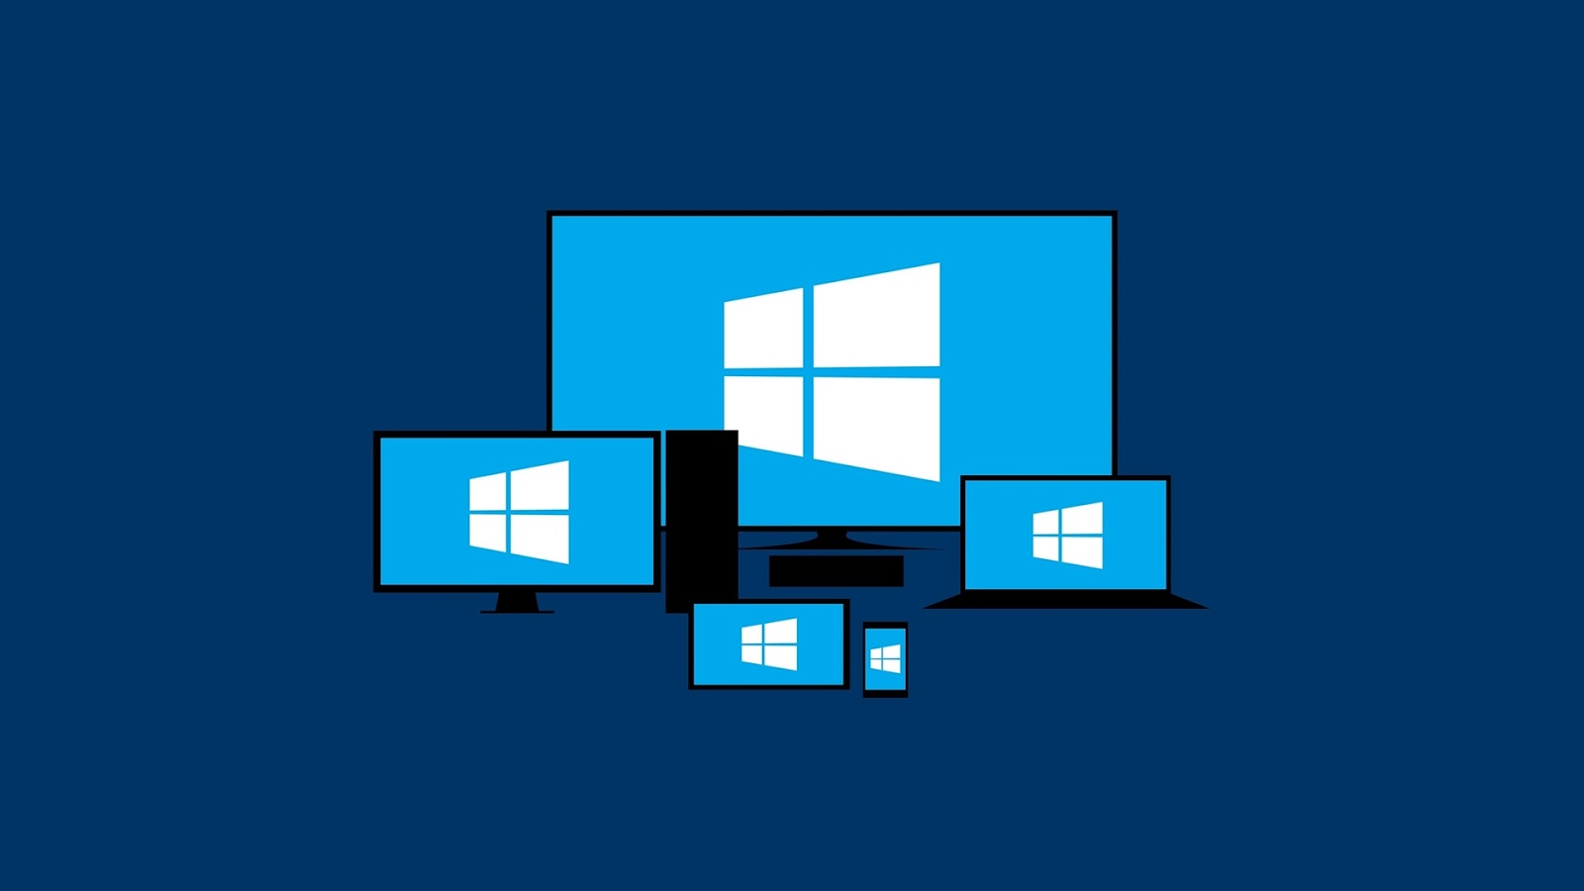
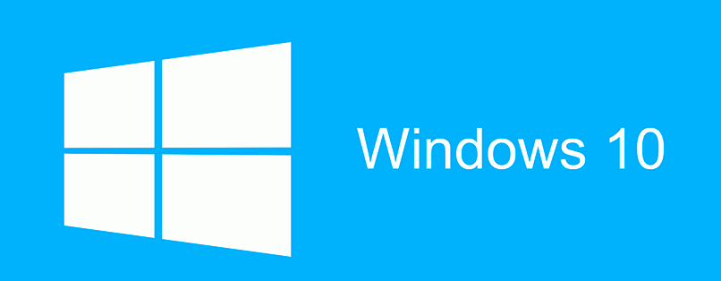

Slide 3
Agenda
Definition of Operating System
Ordinal of Windows Operating System
Minimum System Requirements of Windows 10
Definition of Windows 10
History of Windows
Advantage and Disadvantage of Windows 10
Notes:
Here are the list of topics that we want to inform, it contains

Slide 4
What is Operating System ?
Operating System (OS) is software with the task of controlling and managing hardware as well as basic system operations, including running application software such as data processing programs that can be used to facilitate human activities.

Slide 5
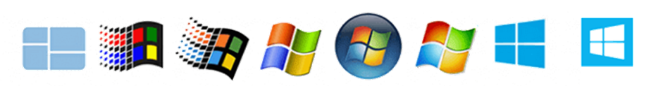
Ordinal of Windows Operating System
Notes:
Win 1 : Nov 20, 85
Win 3.1 : Mar 18, 92
Win 95 : Aug 14, 95
Win XP : Oct 25. 01
Win Vista :
Win 7 :
Win 8 :
Win 10 :

Slide 6
Minimum System Requirements of Windows 10
Some PCs are unable to install Windows 10 because Windows 10 has the requirements to do the installation.
Notes:
Proc : 1 GHz
RAM : 1GB 32-bit 2GB 64-bit
HDS : 32 GB
GC : DirectX 9
Display 800 x 600
IC : necessary to updates, download, and take advantage features, edition require IC Initial device setup

Slide 7
Definition of Windows 10
Windows 10 is a series of personal computer operating systems produced by Microsoft as part of its Windows NT family of operating systems.
Notes:
Windows 10 was released on July 29, 2015. Windows 10 is the successor to Windows 8.1

Slide 8
History of Windows 10
Notes:
Here are the first ever OS that windows created til’ the latest
Starting from DosShell for DOS 6 that made by Microsoft
Then, Microsoft want to compete against the best-selling sales of Apple Macintosh that have used a GUI

Slide 9
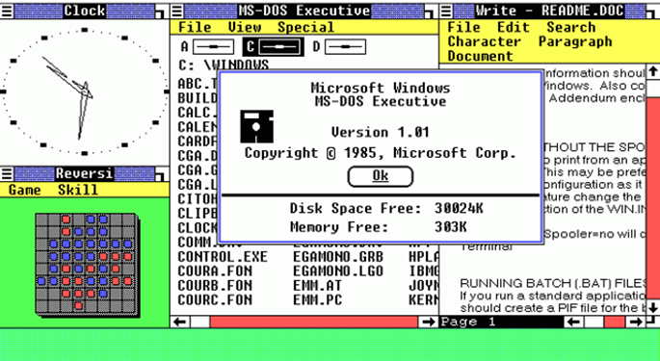
1. Windows 1.0
Notes:
Actually not complete OS, but Operating Environment extends MS-DOS

Slide 10
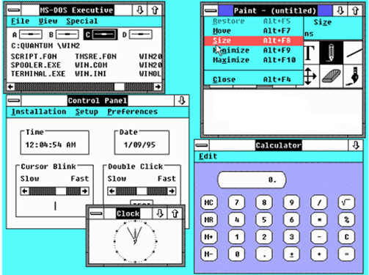
2. Windows 2.0
Notes:
More popular, rises because app, big improve minimize maximize

Slide 11
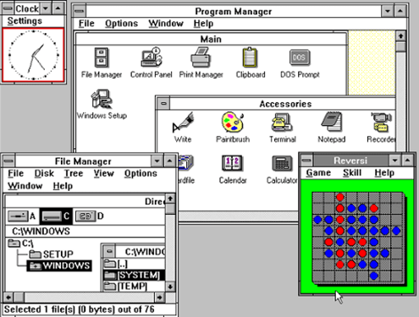
3. Windows 3.0
Notes:
Resembled Mac OS, successful 10 mil

Slide 12
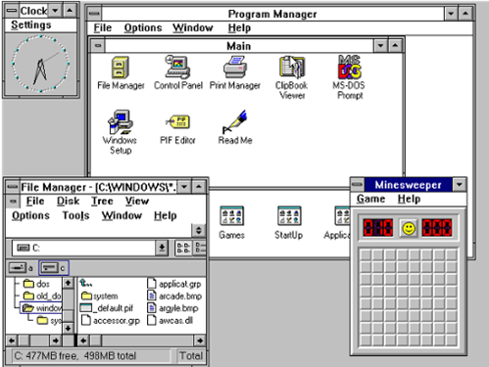
4. Windows 3.1
Notes:
Kinda like 3.0 with some improv, appearance truetype sized fonts, mm sup, bug

Slide 13
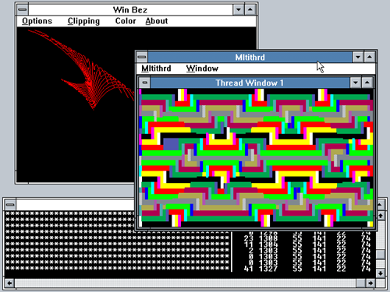
5. Windows NT 3.x
Notes:
Collab alpha dec cpu chip in NT, worth US$150 Mil

Slide 14
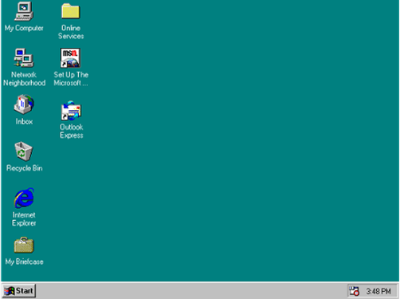
6. Windows 95

Slide 15
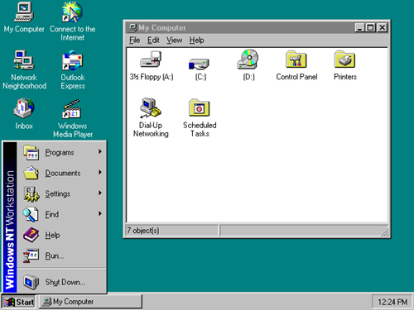
7. Windows NT 4.0

Slide 16
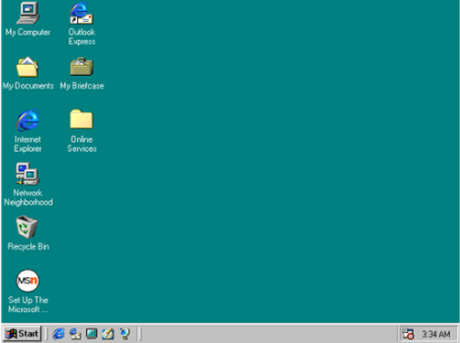
8. Windows 98

Slide 17
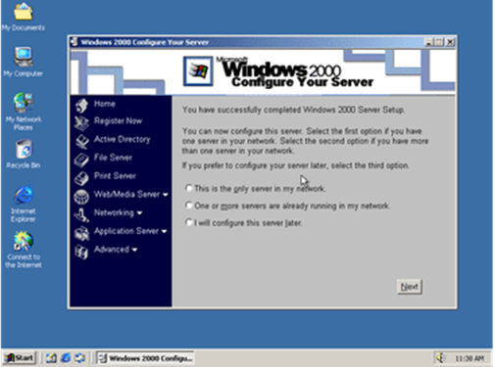
9. Windows 2000

Slide 18
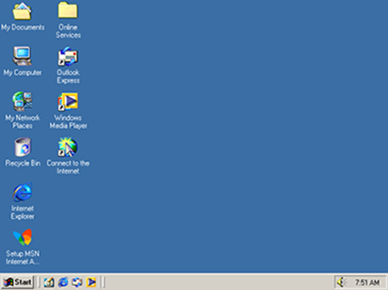
10. Windows ME

Slide 19
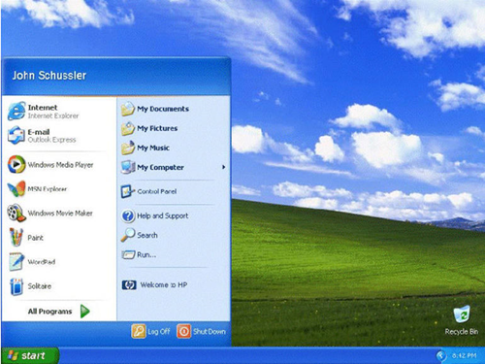
11. Windows XP
Notes:
Oct 2000
Start menu and the taskbar get a visual overhaul
Bringing the green start button
Blue taskbar
Vista wallpaper
Firewall easy to turn off (less secure)

Slide 20
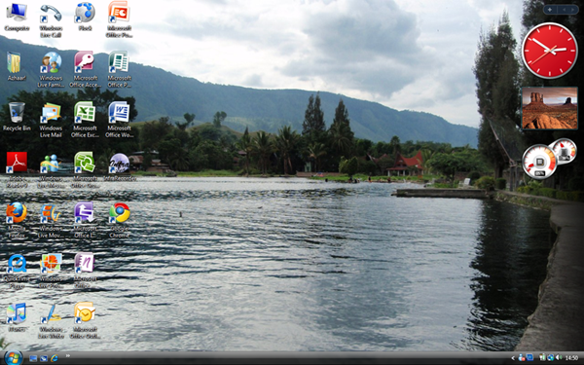
12. Windows Vista
Notes:
January 2007
Updating Look and Feel (Transparant Element)
Starter, Home Basic, Home Premium, Enterprise, Business, Unltimate

Slide 21
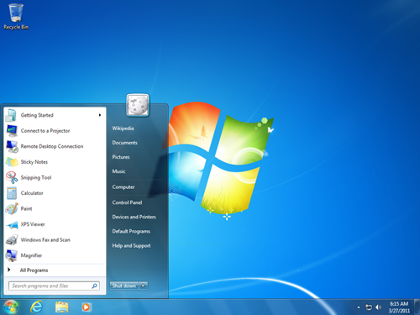
13. Windows 7
Notes:
October 2009
Fix all the problem
Starter, Home Basic, Home Premium, Home Professional, Enterprise, Ultimate, Home Premium and Professional

Slide 22
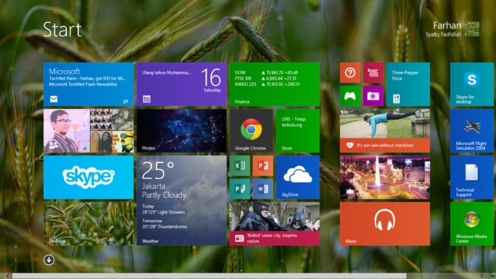
14. Windows 8
Notes:
8 ( Oct 26, 2012) most radical overhaul the user interface.
Friendly start button
Win 8, win 8 pro, win 8 enterprise, win 8 RT
8.1 (June 2013) re-introduced the start button and start screen

Slide 23
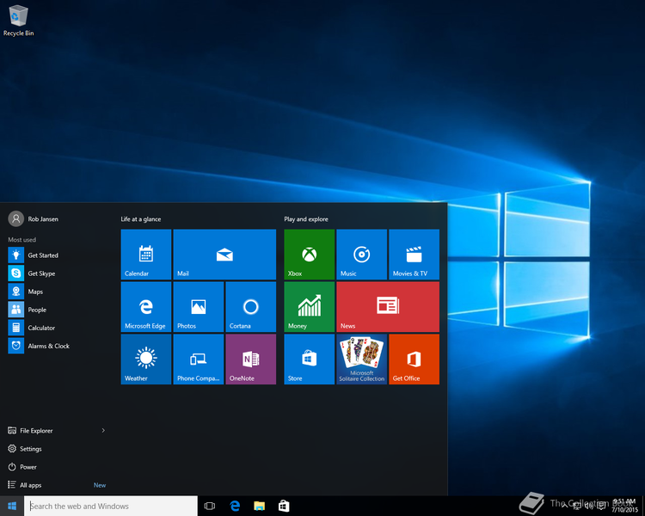
15. Windows 10
Notes:
July 29, 2015
Simultaneously in190 countries
Integrate the advantage win 7 and 8

Slide 24
Edition of Windows 10
Home
Pro
S
Education
Enterprise
Notes:
Home :
Pro :
S : feature limited edition for low-end devices in education market it has faster init. Setup, log process
Edu
Enter

Slide 25
Advantage and Disadvantage Windows 10
The loading time of Windows 10 is much less than that of Windows 7. | User personal information will be shared with Microsoft for better service and improvement.
Windows 10 UI is easy to use because UI Windows 10 integrate the advantages of Windows 7 and 8. | When Windows 7 and 8 are going to be upgraded to Windows 10 sometimes may lead system crashes.
It is safer because Windows 10 is the latest operating system from Windows | Windows 10 is not compatible with old computers, because Windows 10 matches the current computer specifications.
Update Windows 10 with the update button will not damage or delete your files. | Windows 10 often show pop up notifications to be updated to the latest system.

Slide 26
Features of Windows 10
Notes:
Here are the new features or the most popular features from Microsoft that added on Windows 10

Slide 27
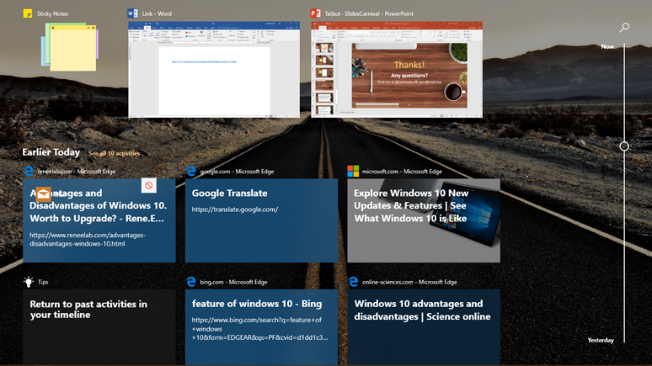
Timeline
Notes:
Timeline is an experience that debuts with April 2018 Update, and it introduces a new way to resume act in past

Slide 28
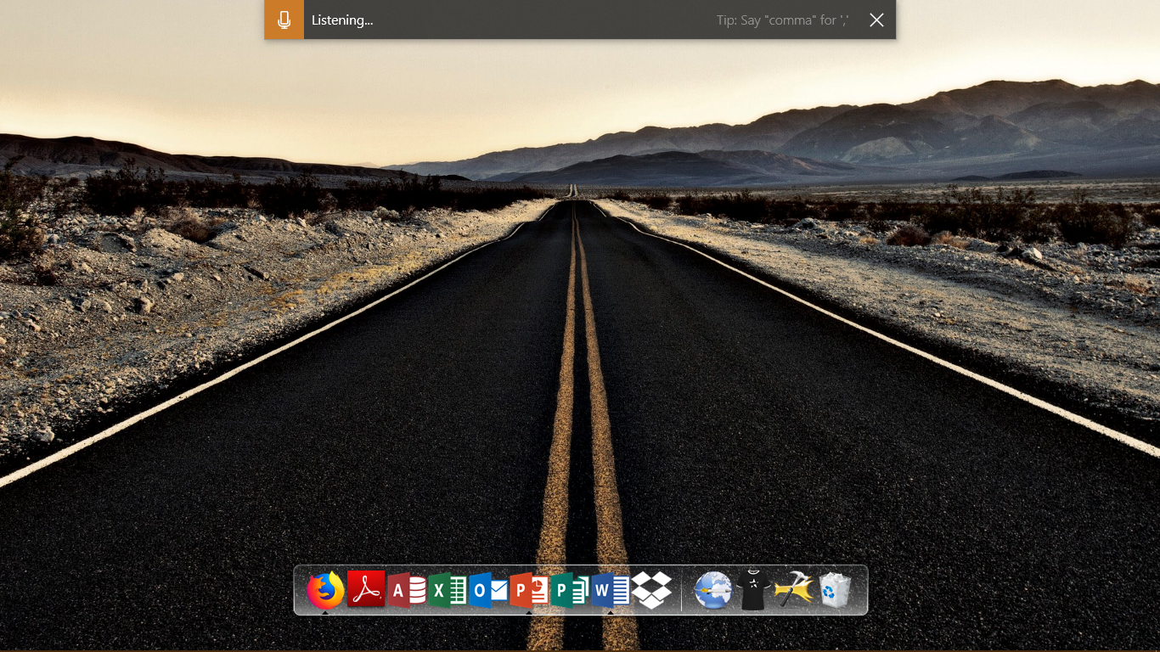
Talk instead of type

Slide 29
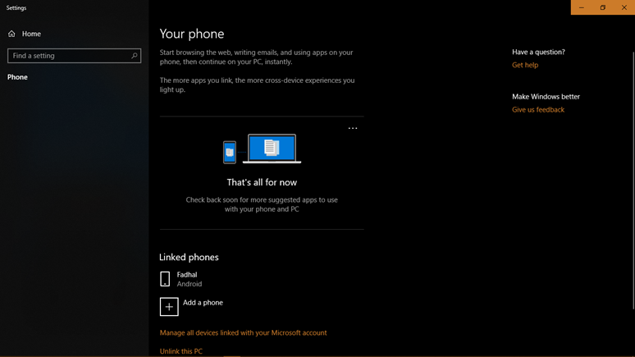
Switch Seamlessly from Your Phone to PC

Slide 30
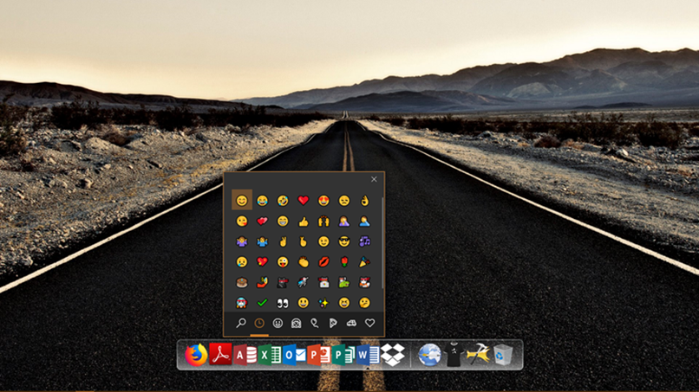
Add Emoji from Your Keyboard

Slide 31
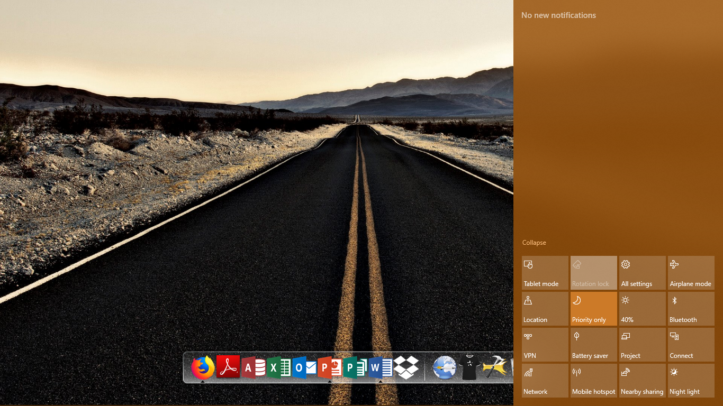
Focus Assist

Slide 32
Conclusion & Suggestion

Slide 33
Conclusion From this ISAS, we can conclude that for now, Windows 10 is the latest and one of the best Windows ever released by Microsoft. With features that make it easy for users to do activities, sophisticated user interface, the price offered is following the usability.

Slide 34
Suggestion If you want to use Windows 10, the author recommends using Windows 10 Pro because it has features that meet the needs of all users. However, if the user needs to focus on certain needs, many editions of Windows 10 can be chosen by the user.

Slide 35
Thanks!
Any questions?

Slide 36
SlidesCarnival icons are editable shapes. This means that you can:
Resize them without losing quality.
Change fill color and opacity.
Change line color, width and style.
Isn’t that nice? :) Examples:

Slide 37
You can also use any emoji as an icon! And of course it resizes without losing quality. How? Follow Google instructions https://twitter.com/googledocs/status/730087240156643328
✋👆👉👍👤👦👧👨👩👪💃🏃💑❤😂😉😋😒😭👶😸🐟🍒🍔💣📌📖🔨🎃🎈🎨🏈🏰🌏🔌🔑 and many more...

